Slide 1
Introduction to HDF5
Session 7
Datatypes
Copyright © 2010 The HDF Group. All Rights Reserved

Slide 2
An HDF5 Datatype is…
A description of dataset element type
Grouped into “classes”:
  Atomic – integers, floating-point values
  Enumerated
  Compound – like C structs
  Array
  Opaque
  References
    Object – similar to soft link
    Region – similar to soft link to dataset + selection
  Variable-length
    Strings – fixed and variable-length
    Sequences – similar to Standard C++ vector class
Copyright © 2010 The HDF Group. All Rights Reserved

Slide 3
HDF5 Datatypes
HDF5 has a rich set of pre-defined datatypes and supports the creation of an unlimited variety of complex user-defined datatypes.
Self-describing:
  Datatype definitions are stored in the HDF5 file with the data.
  Datatype definitions include information such as byte order (endianess), size, and floating point representation to fully describe how the data is stored and to insure portability across platforms.
Copyright © 2010 The HDF Group. All Rights Reserved

Slide 4
Datatype Conversion
Datatypes that are compatible, but not identical are converted automatically when I/O is performed
Compatible datatypes:
  All atomic datatypes are compatible
  Identically structured array, variable-length and compound datatypes whose base type or fields are compatible
  Enumerated datatype values on a “by name” basis
Make datatypes identical for best performance
Copyright © 2010 The HDF Group. All Rights Reserved

Slide 5
Datatype Conversion Example
Array of integers on IA32 platform
Native integer is little-endian, 4 bytes
Array of integers on SPARC64 platform
Native integer is big-endian, 8 bytes
H5T_NATIVE_INT
H5T_NATIVE_INT
H5Dwrite
Little-endian 4 bytes integer
H5Dread
H5Dwrite
H5T_STD_I32LE
VAX G-floating
Copyright © 2010 The HDF Group. All Rights Reserved

Slide 6
Storing Records with HDF5
Copyright © The HDF Group. All Rights Reserved

Slide 7
HDF5 Compound Datatypes
Compound types
  Comparable to C structs
  Members can be any datatype
  Can write/read by a single field or a set of fields
  Not all data filters can be applied (shuffling, SZIP)
Copyright © The HDF Group. All Rights Reserved

Slide 8
HDF5 Compound Datatypes
Which APIs to use?
  H5TB APIs
    Create, read, get info and merge tables
    Add, delete, and append records
    Insert and delete fields
    Limited control over table’s properties (i.e. only GZIP compression, level 6, default allocation time for table, extendible, etc.)
  PyTables http://www.pytables.org
    Based on H5TB
    Python interface
    Indexing capabilities
  HDF5 APIs
    H5Tcreate(H5T_COMPOUND), H5Tinsert calls to create a compound datatype
    H5Dcreate, etc.
    See H5Tget_member* functions for discovering properties of the HDF5 compound datatype
Copyright © The HDF Group. All Rights Reserved

Slide 9
Creating and Writing Compound Dataset
h5_compound.c example
typedef struct s1_t {
int a;
float b;
double c;
} s1_t;
s1_t s1[LENGTH];
Copyright © The HDF Group. All Rights Reserved

Slide 10
Creating and Writing Compound Dataset
/* Create datatype in memory. */
s1_tid = H5Tcreate(H5T_COMPOUND, sizeof(s1_t));
H5Tinsert(s1_tid, "a_name", HOFFSET(s1_t, a),
H5T_NATIVE_INT);
H5Tinsert(s1_tid, "c_name", HOFFSET(s1_t, c),
H5T_NATIVE_DOUBLE);
H5Tinsert(s1_tid, "b_name", HOFFSET(s1_t, b),
H5T_NATIVE_FLOAT);
Note:
Use HOFFSET macro instead of calculating offset by hand.
Order of H5Tinsert calls is not important if HOFFSET is used.
Copyright © The HDF Group. All Rights Reserved

Slide 11
Creating and Writing Compound Dataset
/* Create dataset and write data */
dataset = H5Dcreate(file, DATASETNAME, s1_tid, space,
H5P_DEFAULT, H5P_DEFAULT);
status = H5Dwrite(dataset, s1_tid, H5S_ALL, H5S_ALL,
H5P_DEFAULT, s1);
Note:
In this example memory and file datatypes are the same.
Type is not packed.
Use H5Tpack to save space in the file.
status = H5Tpack(s1_tid);
status = H5Dcreate(file, DATASETNAME, s1_tid, space,
H5P_DEFAULT, H5P_DEFAULT);
Copyright © The HDF Group. All Rights Reserved

Slide 12
Reading Compound Dataset
/* Create datatype in memory and read data. */
dataset = H5Dopen(file, DATASETNAME, H5P_DEFAULT);
s2_tid = H5Dget_type(dataset);
mem_tid = H5Tget_native_type(s2_tid);
buf = malloc(H5Tget_size(mem_tid)*number_of_elements);
status = H5Dread(dataset, mem_tid, H5S_ALL,
H5S_ALL, H5P_DEFAULT, buf);
Note:
We could construct memory type as we did in writing example.
For general applications we need to discover the type in the file, find out corresponding memory type, allocate space and do read.
Copyright © The HDF Group. All Rights Reserved

Slide 13
Reading Compound Dataset by Fields
typedef struct s2_t {
double c;
int a;
} s2_t;
s2_t s2[LENGTH];
…
s2_tid = H5Tcreate (H5T_COMPOUND, sizeof(s2_t));
H5Tinsert(s2_tid, "c_name", HOFFSET(s2_t, c),
H5T_NATIVE_DOUBLE);
H5Tinsert(s2_tid, “a_name", HOFFSET(s2_t, a),
H5T_NATIVE_INT);
…
status = H5Dread(dataset, s2_tid, H5S_ALL,
H5S_ALL, H5P_DEFAULT, s2);
Copyright © The HDF Group. All Rights Reserved

Slide 14
Table Example
a_name (integer) | b_name (float) | c_name (double)
0 | 0. | 1.0000
1 | 1. | 0.5000
2 | 4. | 0.3333
3 | 9. | 0.2500
4 | 16. | 0.2000
5 | 25. | 0.1667
6 | 36. | 0.1429
7 | 49. | 0.1250
8 | 64. | 0.1111
9 | 81. | 0.1000
Multiple ways to store a table
Dataset for each field
Dataset with compound datatype
If all fields have the same type:
  2-dim array
  1-dim array of array datatype
Continued…
Choose to achieve your goal!
Storage overhead?
Do I always read all fields?
Do I read some fields more often?
Do I want to use compression?
Do I want to access some records?
Copyright © The HDF Group. All Rights Reserved

Slide 15
Storing Variable Length Data with HDF5
Copyright © The HDF Group. All Rights Reserved

Slide 16
HDF5 Fixed and Variable Length Array Storage
Data
Time
Data
Data
Data
Data
Time
Data
Data
Data
Data
Copyright © The HDF Group. All Rights Reserved

Slide 17
Storing Strings in HDF5
Array of characters (Array datatype or extra dimension in dataset)
  Quick access to each character
  Extra work to access and interpret each string
Fixed length
  string_id = H5Tcopy(H5T_C_S1);
  H5Tset_size(string_id, size);
    Wasted space in shorter strings
    Can be compressed
Variable length
  string_id = H5Tcopy(H5T_C_S1);
  H5Tset_size(string_id, H5T_VARIABLE);
    Overhead as for all VL datatypes
    Compression will not be applied to actual data
Copyright © The HDF Group. All Rights Reserved

Slide 18
Storing Variable Length Data in HDF5
Each element is represented by C structure
  typedef struct {
  size_t length;
  void *p;
  } hvl_t;
Base type can be any HDF5 type
  H5Tvlen_create(base_type)
Copyright © The HDF Group. All Rights Reserved

Slide 19
Example
hvl_t data[LENGTH];
for(i=0; i<LENGTH; i++) {
data[i].p = malloc((i+1)*sizeof(unsigned int));
data[i].len = i+1;
}
tvl = H5Tvlen_create (H5T_NATIVE_UINT);
data[0].p
Data
Data
Data
Data
data[4].len
Data
Copyright © The HDF Group. All Rights Reserved

Slide 20
Reading HDF5 Variable Length Array
HDF5 library allocates memory to read data in
Application only needs to allocate array of hvl_t elements (pointers and lengths)
Application must reclaim memory for data read in
hvl_t rdata[LENGTH];
/* Create the memory vlen type */
tvl = H5Tvlen_create(H5T_NATIVE_INT);
ret = H5Dread(dataset, tvl, H5S_ALL, H5S_ALL,
H5P_DEFAULT, rdata);
/* Reclaim the read VL data */
H5Dvlen_reclaim(tvl, H5S_ALL, H5P_DEFAULT,rdata);
Copyright © The HDF Group. All Rights Reserved

Slide 21
HDF5 Reference Datatypes
Copyright © The HDF Group. All Rights Reserved

Slide 22
Reference Datatypes
Object Reference
  Pointer to an object in a file
  Predefined datatype H5T_STD_REG_OBJ
Dataset Region Reference
  Pointer to a dataset + dataspace selection
  Predefined datatype H5T_STD_REF_DSETREG
Copyright © The HDF Group. All Rights Reserved

Slide 23
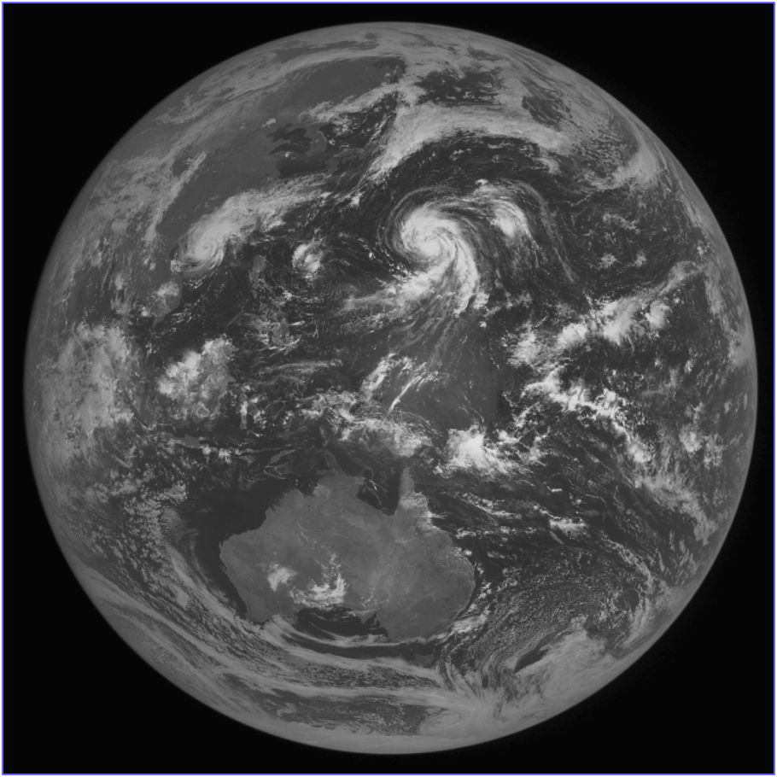
Saving Selected Region in a File
Need to select and access the same
elements of a dataset
Copyright © The HDF Group. All Rights Reserved

Slide 24
Reference to Dataset Region
REF_REG.h5
Root
Matrix
Region References
1 1 2 3 3 4 5 5 6
1 2 2 3 4 4 5 6 6
Copyright © The HDF Group. All Rights Reserved

Slide 25
Reference to Dataset Region
Example
dsetr_id = H5Dcreate(file_id,
“REGION REFERENCES”, H5T_STD_REF_DSETREG, …);
H5Sselect_hyperslab(space_id,
H5S_SELECT_SET, start, NULL, …);
H5Rcreate(&ref[0], file_id, “MATRIX”, H5R_DATASET_REGION, space_id);
H5Dwrite(dsetr_id, H5T_STD_REF_DSETREG, H5S_ALL, H5S_ALL, H5P_DEFAULT, ref);
Copyright © The HDF Group. All Rights Reserved

Slide 26

Stretch Break
Copyright © 2010 The HDF Group. All Rights Reserved

